Slide 1
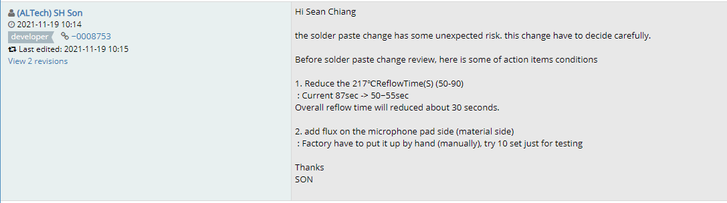
K18X001.00- MIC Soldering issue
I. Description:
- On 11/19, Customer sent request to do verify improvement void solder of MIC parts:
Reduce the 217ºC reflow time (50-90secs): Current 87 secs to 50~55 secs (About 30 secs)
Add flux on the microphone pad side (on material) and mount by hand
Firstly, FXC will modify the reflow profile as customer request.
Listens to customers, Meet customer expectation

Slide 2
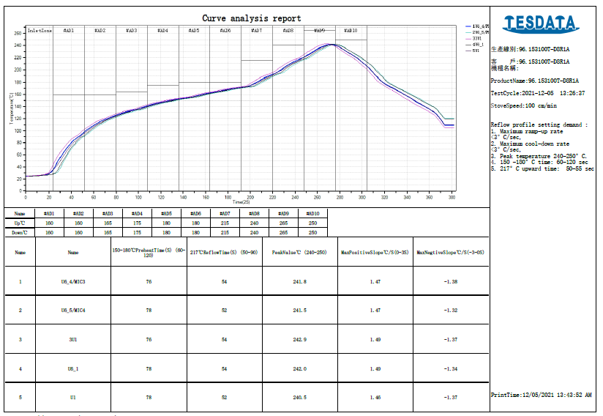
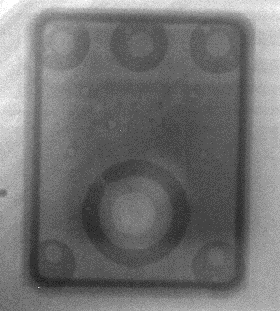
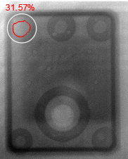
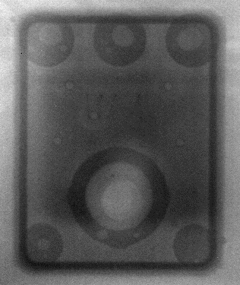
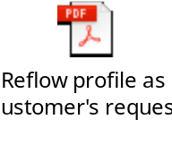
K18X001.00- MIC Soldering issue
II. Reflow profile as customer’s request:
Reflow profile as attached file
Scan X-RAY 50pcs: Some MIC parts were defect:
+ Solder ball: 5/200 (2.5%)
+ Void solder: 5/200(2.5%)
+ O-ring not seal: 4/200 (2.0%)
Summary: Void solder maximum<35%
OP will VI by magnifier &remove solder ball at AOI-post
O-ring not seal: Need to verify testing program then repair
→ Try to optimize reflow profile
Listens to customers, Meet customer expectation

Slide 3
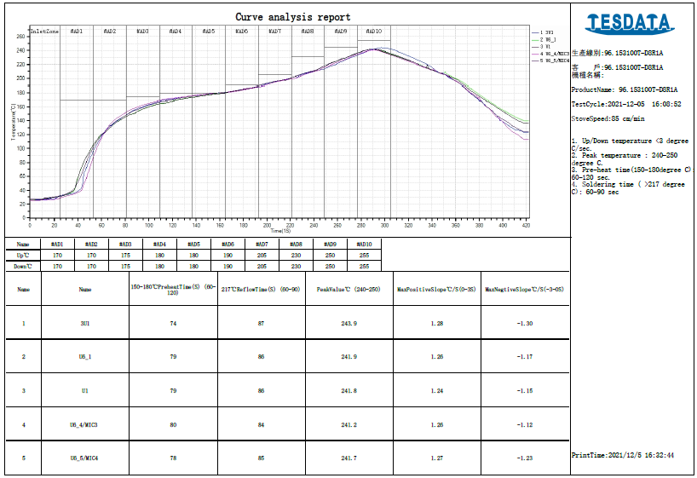

K18X001.00- MIC Soldering issue
III. FXC optimize reflow profile:
Reflow profile is followed as vendor ’suggestion
Scan X-RAY 50pcs: Some MIC parts were defect:
+ Solder ball: 5/200 (2.5%)
+ Void solder: 3/200 (1.5%)
+ O-ring not seal: 0/200 (0.0%)
COMPARING REFLOW PROFILE
Item | Profile feature | Vendor suggest | U6_4/MIC3 | U6_5/MIC4
1 | Ramp-up rate (Tsmax to Tp) | 3°C/second max | 0.88 | 0.82
2 | Preheat Time (150-200°C) (ts) | 60-180 seconds | 80 | 78
3 | Soldering time(TL>217°C) (tL) | 60-150 seconds | 84 | 85
4 | Peak Temperature (Tp) | <260°C ( Suggest 240-245°C) | 241.2 | 241.7
5 | Time within 5°C of actual peak temperature (tp) | 20-40 seconds | 25 | 26
6 | Ramp-down rate (Tp to Tsmax) | 6°C/second max | -0.79 | -0.87
Summary: Void solder maximum<35%
OP will VI by magnifier &remove solder ball at AOI-post
O-ring is better
Listens to customers, Meet customer expectation

Slide 4



K18X001.00- MIC Soldering issue
IV. Compare between reflow profiles:
Status | NPI stage (100pcs) |  |  | Customer's request Profile (50pcs) |  |  | FXC optimize profile (50pcs)
 | Fail Q'Ty (pcs) | Total | Defect rate | Fail Q'Ty (pcs) | Total | Defect rate | Fail Q'Ty (pcs) | Total | Defect rate
Void solder >30% | 11 | 400 | 2.75% | 5 | 200 | 2.50% | 3 | 200 | 1.50%
Solder ball | 17 | 400 | 4.25% | 5 | 200 | 2.50% | 5 | 200 | 2.50%
O-ring not seal | 0 | 400 | 0.00% | 4 | 200 | 2.00% | 0 | 200 | 0.00%
V. Verify testing program:
3pcs defect ( total 4 positions) were tested on line.
Result: pass
Summary:
- The solder ball rate seem be better a little but it is not improved completely. → Will modify stencil and verify new solder paste.
- Void solder is also better. The maximum void solder is not over 35%
- Reflow as customer’s request may affect to O-ring sealing
Listens to customers, Meet customer expectation

